Slide 1
Online recognition algorithm

Slide 2
Learning

Slide 3
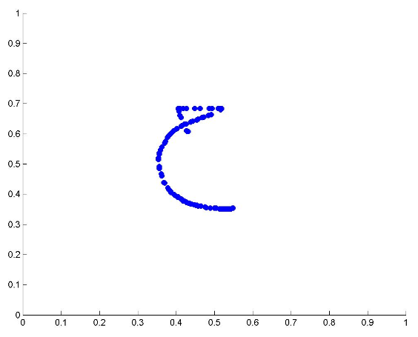


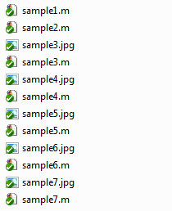
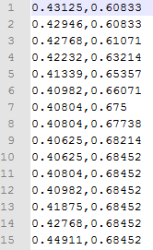
Letters raw data

Slide 4

Building the Letters Dictionary
For each Letter
For Each Position
The outcome of this process is 4 kdtree data structures for each Letters Position.
And some extra data as the coeff matrix of PCA and LDA

Slide 5
Recognition

Slide 6
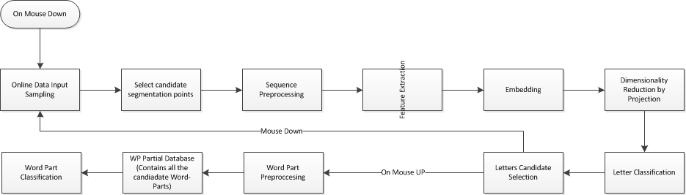
Online Recognition process Overview

Slide 7
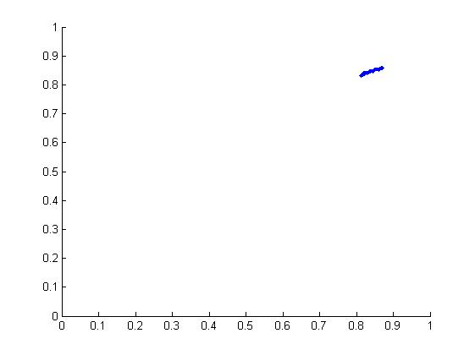
Segmentation and recognition is done while the word is being scribed.

Slide 8
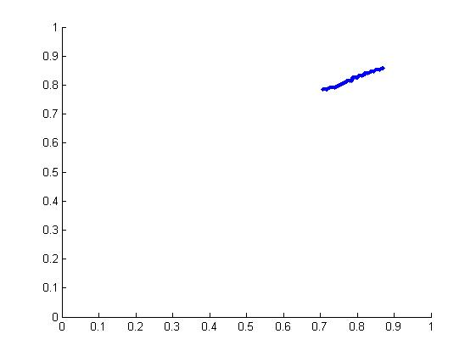
Demarcation points are residents of Horizontal segments.
Horizontal Segment:
Low Slope
Forward (right to Left)
We look for horizontal segments while progressing.

Slide 9
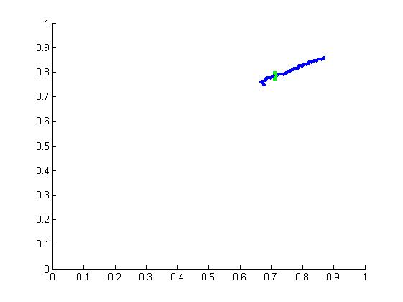
Legend
Green – Horizontal Segment start (StartHS)
Black – Horizontal Segment End (EndHS)
Blue – Candidate Point
Red – Segmentation Point

Slide 10
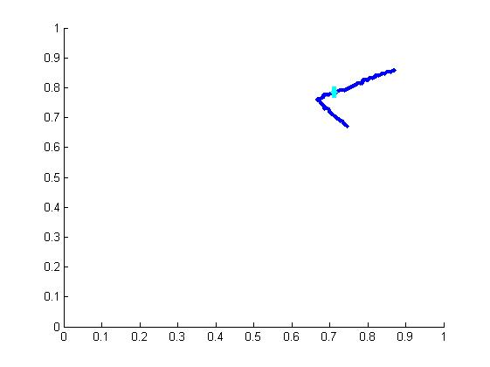
MidPoint – is the medial point between the StartHS and the EndHS.
MidPoint is classified as Candidate Point or Cratical Point.
Horizontal segment detected.
Set as candidate point.

Slide 11
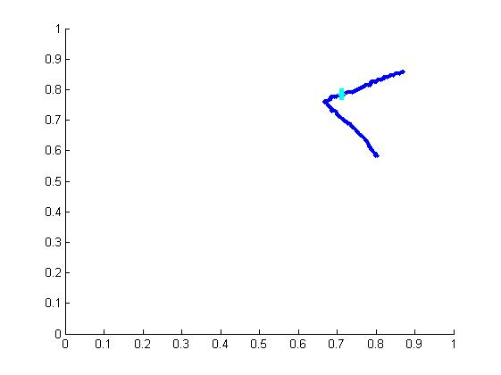
The classified subsequence is always from the last segmentation point to current candidate point.

Slide 12
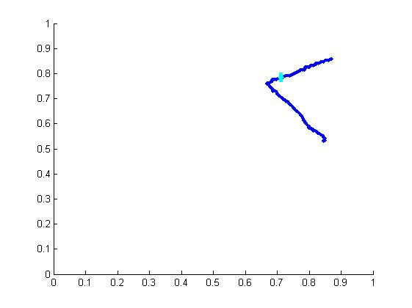
Conditions of Start HS:
Small slope.
The simplified sequence contains more than 3 points.
To make sure the sequence contain enough info.
The direction of the line is right to left.
The segmentation point is on the baseline (Effective from the 3’rd candidate point.)

Slide 13
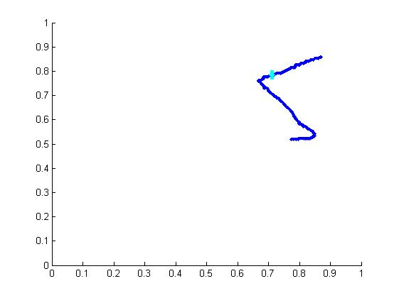
Conditions of EndHS
High slope Or directed Backwards.
Take the last seen horizontal point to be EndHS point.

Slide 14
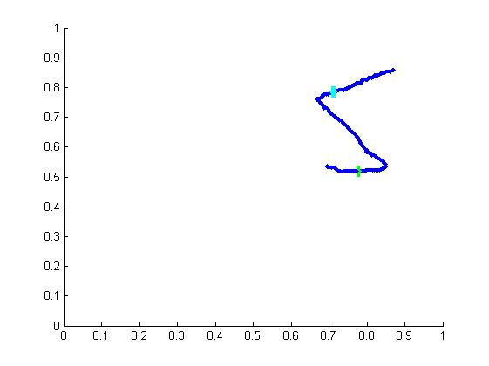
Start Horizontal Segment

Slide 15
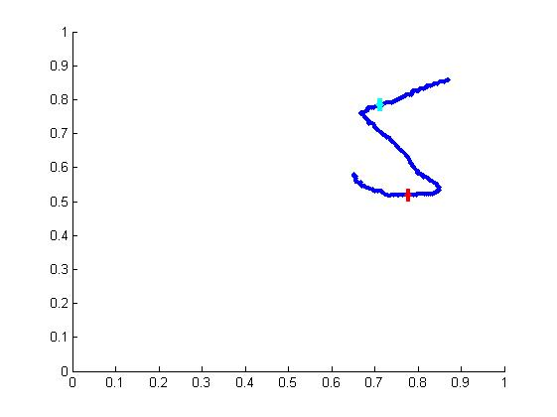
End Horizontal Segment.
Choose the best segmentation point between the last 2 candidate points.
In this case, the second candidate point was taken as the segmentation point.

Slide 16
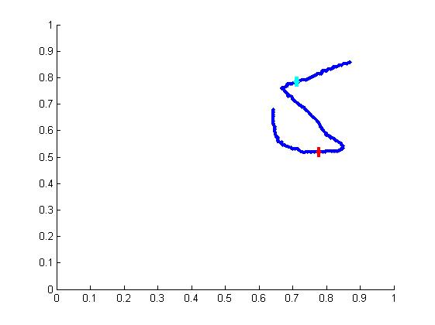
The first point represents the subsequence:
0 - blue point.
The second point represent the subsequence:
0 - red point.
Now there is no candidate point since the second candidate was selected as the segmentation points.

Slide 17
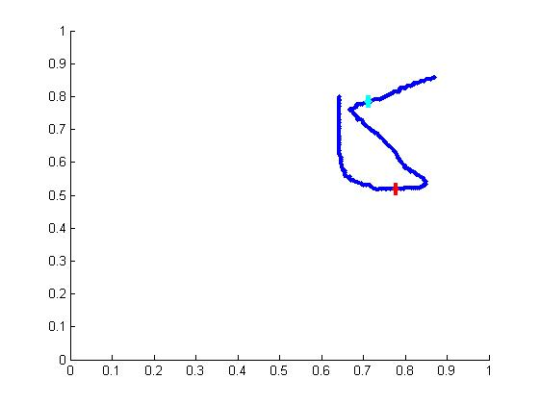
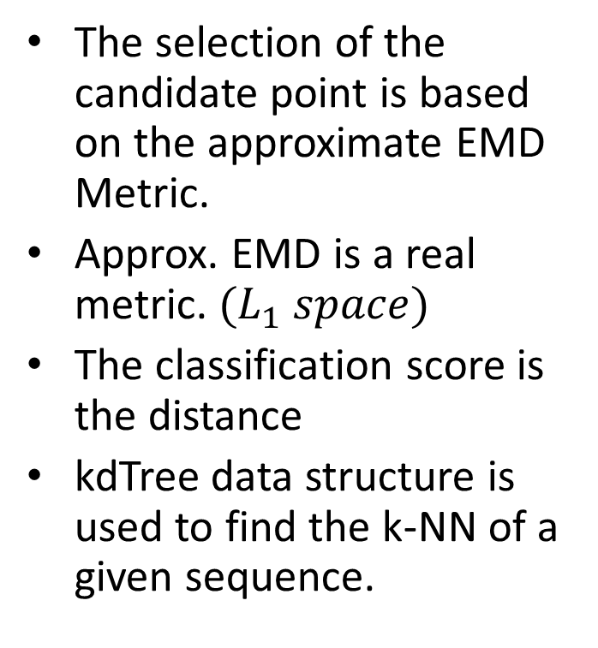
The selection of the candidate point is based on the approximate EMD Metric.
Approx. EMD is a real metric. ${(L}_{1} space)$
The classification score is the distance
kdTree data structure is used to find the k-NN of a given sequence.

Slide 18
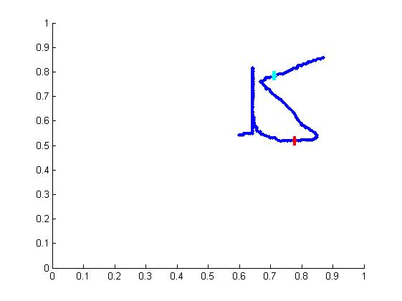
The candidates are the 3-NN.
Each candidate has a classification score.
The candidate point with the minimum classification score is selected.

Slide 19
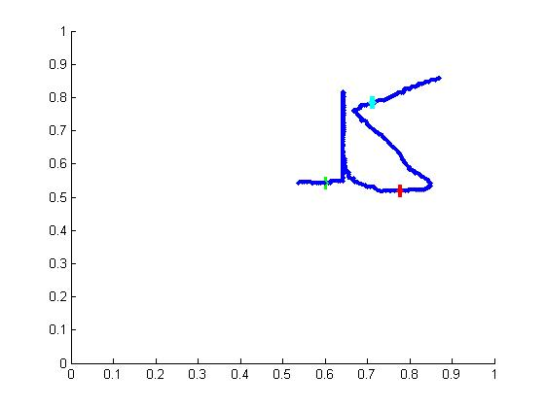

Slide 20
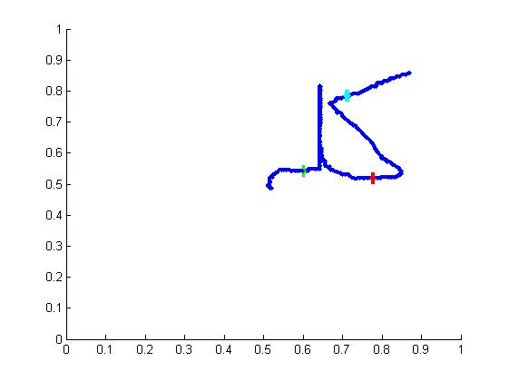

Slide 21
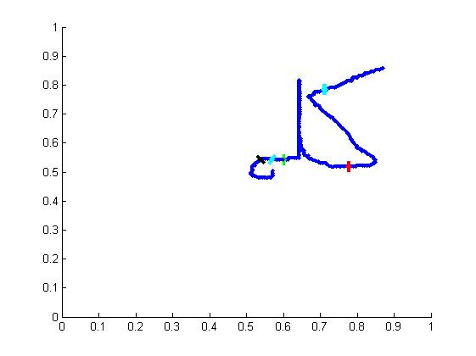

Slide 22
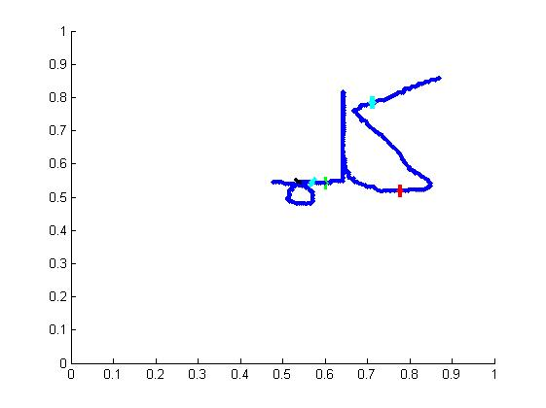

Slide 23
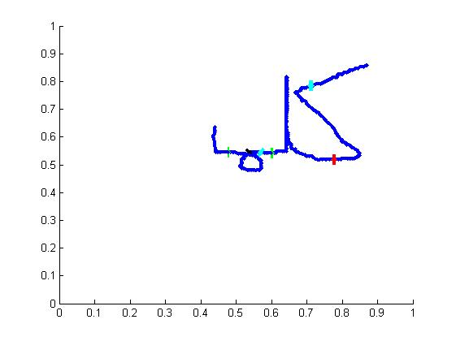

Slide 24
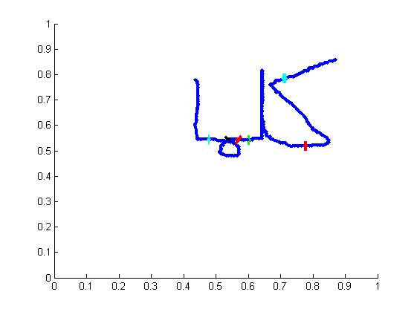

Slide 25
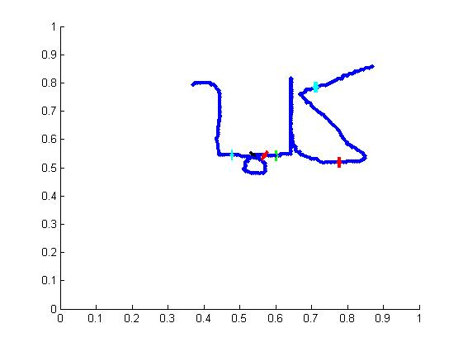
MouseUp: The event of ending a stroke.
If there is no candidate point:
Option 1: The last point is a demarcation point.
Option 2: Demarcation point translation.

Slide 26
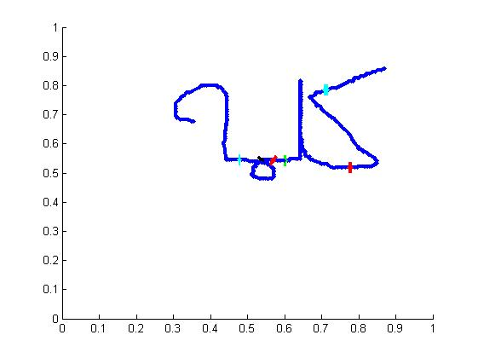
If there is a candidate point
Option 1: Both the candidate point and the last point are demarcation points
Option 2: only the last point is a demarcation point.

Slide 27
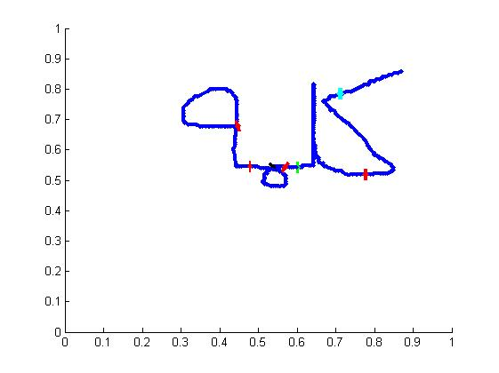
In this case Option 1 was selected.
Mouse UP - In special cases a critical point translation was implemented.
If the Last segmentation point is too close to the MouseUp event

Slide 28

Preprocessing
Every Sequence passes through 3 filters in the following order:
Normalization
Simplification
Using Recursive Douglas-Peucker Polyline Simplification.
Proportional Sensitivity parameter:
Absolute Sensitivity Parameter:
Resampling
Using splines.
Classification resampling size: 40 (points)
Processing resampling size: #proptional*5

Slide 29
In-progress Baseline detection
Segmentation points are usually placed on the baseline.
2 or more segmentation points define the word baseline.
Find the baseline using linear regression.
A new segmentation point is nominated only of it is sufficiently close to the baseline.

Slide 30
Classification
A separate data structure for each position.
Feature: shape context.
Approx. EMD Embedding – coif1/coif2.
K-NN data structure: kdtree.

Slide 31
Dimensionality Reduction
We use PCA in the first phase and LDA in the second phase.
PCA data preservation rate=0.98
LDA Reduces 1 dimension.
We achieved ~8-13 dimensions. (Depending on the position)

Slide 32
Limitations
A stroke (sequence) always contains a WP.
A letter is written is a single stroke.
We don’t handle additional strokes
Special cases we don’t handle:
Letters like س, which can be recognized as a sequence of 2 or 3 ب.
We do not differentiate between ط and ص.
We do not have ن and ي in Mid and Ini position in the validation test, as both can’t be differentiate from ب
Very small sample set.
~7 samples for each class.
Interesting to see how the system will behave when we will have much larger samples for each class.
We expect to have minimum of 20 samples for each letter class.

Slide 33
Test Setup
Test set size: 521 WPs
Average WP length 4.9 [letters].
Number of letters samples: 7.
The WP length is distributed uniformly.
We evaluate recognition rate and segmentation rates.
Recognition parameters:
K = 10
Max slope: 0.5
Max deviation from baseline = 0.15
Method – Blind Test. (leave one out)
Top 3 – if one of the top 3 suggestion is correct => the letter was classified correctly.
Nor Test WP Neither training letter set do not contain the following letters:
ط ء لا ـك ـكـ س (كـ is included)

Slide 34
Results
 | Segmentation Rate [%] | Recognition Rate [%] | AVG Recognition time [sec]
Blind Test (sample 2) | 88.48 | 81.19 | 2.71
Blind Test (sample 4) | 73.32 | 65.45 | 1.74
Blind Test (sample 6) | 89.44 | 83.88 | 1.43
Blind Test (sample 7) | 71.98 | 45.11 | 1.73
Average Leave one out | 80.81 | 68.91 | 1.90
Seen Letters | 94 | 93.5 | 1.39

Slide 35
Conclusion
Good Performance.
We assume it will stay low even when we have a large training set – kdtree & low number of dimensions.
Fair recognition and segmentation percentage, considering the following facts:
Some generated words are distorted and almost unreadable by human.
Very few training samples.
We need more training data.

Slide 36
Enhancements
Improve the segmentation point selection
Try to the learn the region of the segmentation point and use it to give scores to the segmentation points candidates.
Features: shape context Or angles
Classification: 2-class SVM
Validate the segmentation point is not in a loop.

Slide 37
Enhancements Cont.
Adjust the legal slope range according to the baseline slope.
Waive the assumption that a stroke contains a WP, i.e. has the following structure: [Ini,Med*,Fin]. --Done
Waive the assumption that a letter is written in a single stroke.
Add Ligatures - complex Letters such as لما and محـ.
Code and performance Refactoring!

Slide 38
Live Demo

